Slide 1
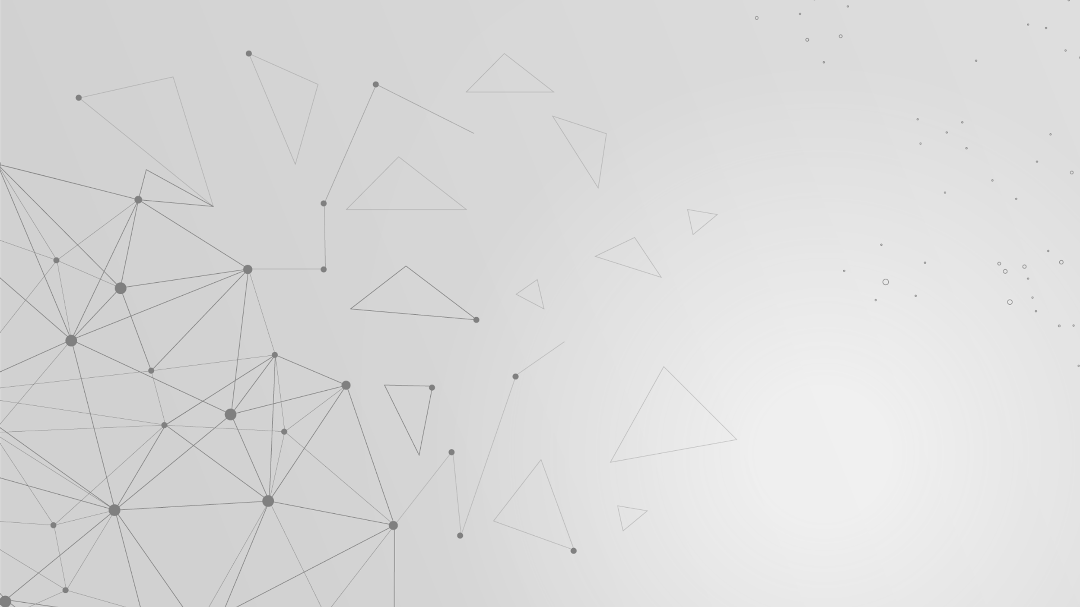
A Rubik's Cube Solution Using Deep Learning and Robotic Arm Coordination
Group 5-11
Advisor: JENN-JIER JAMES LIEN
Members: HSING-YU LIN, YEN-SHUN LEE

Slide 2
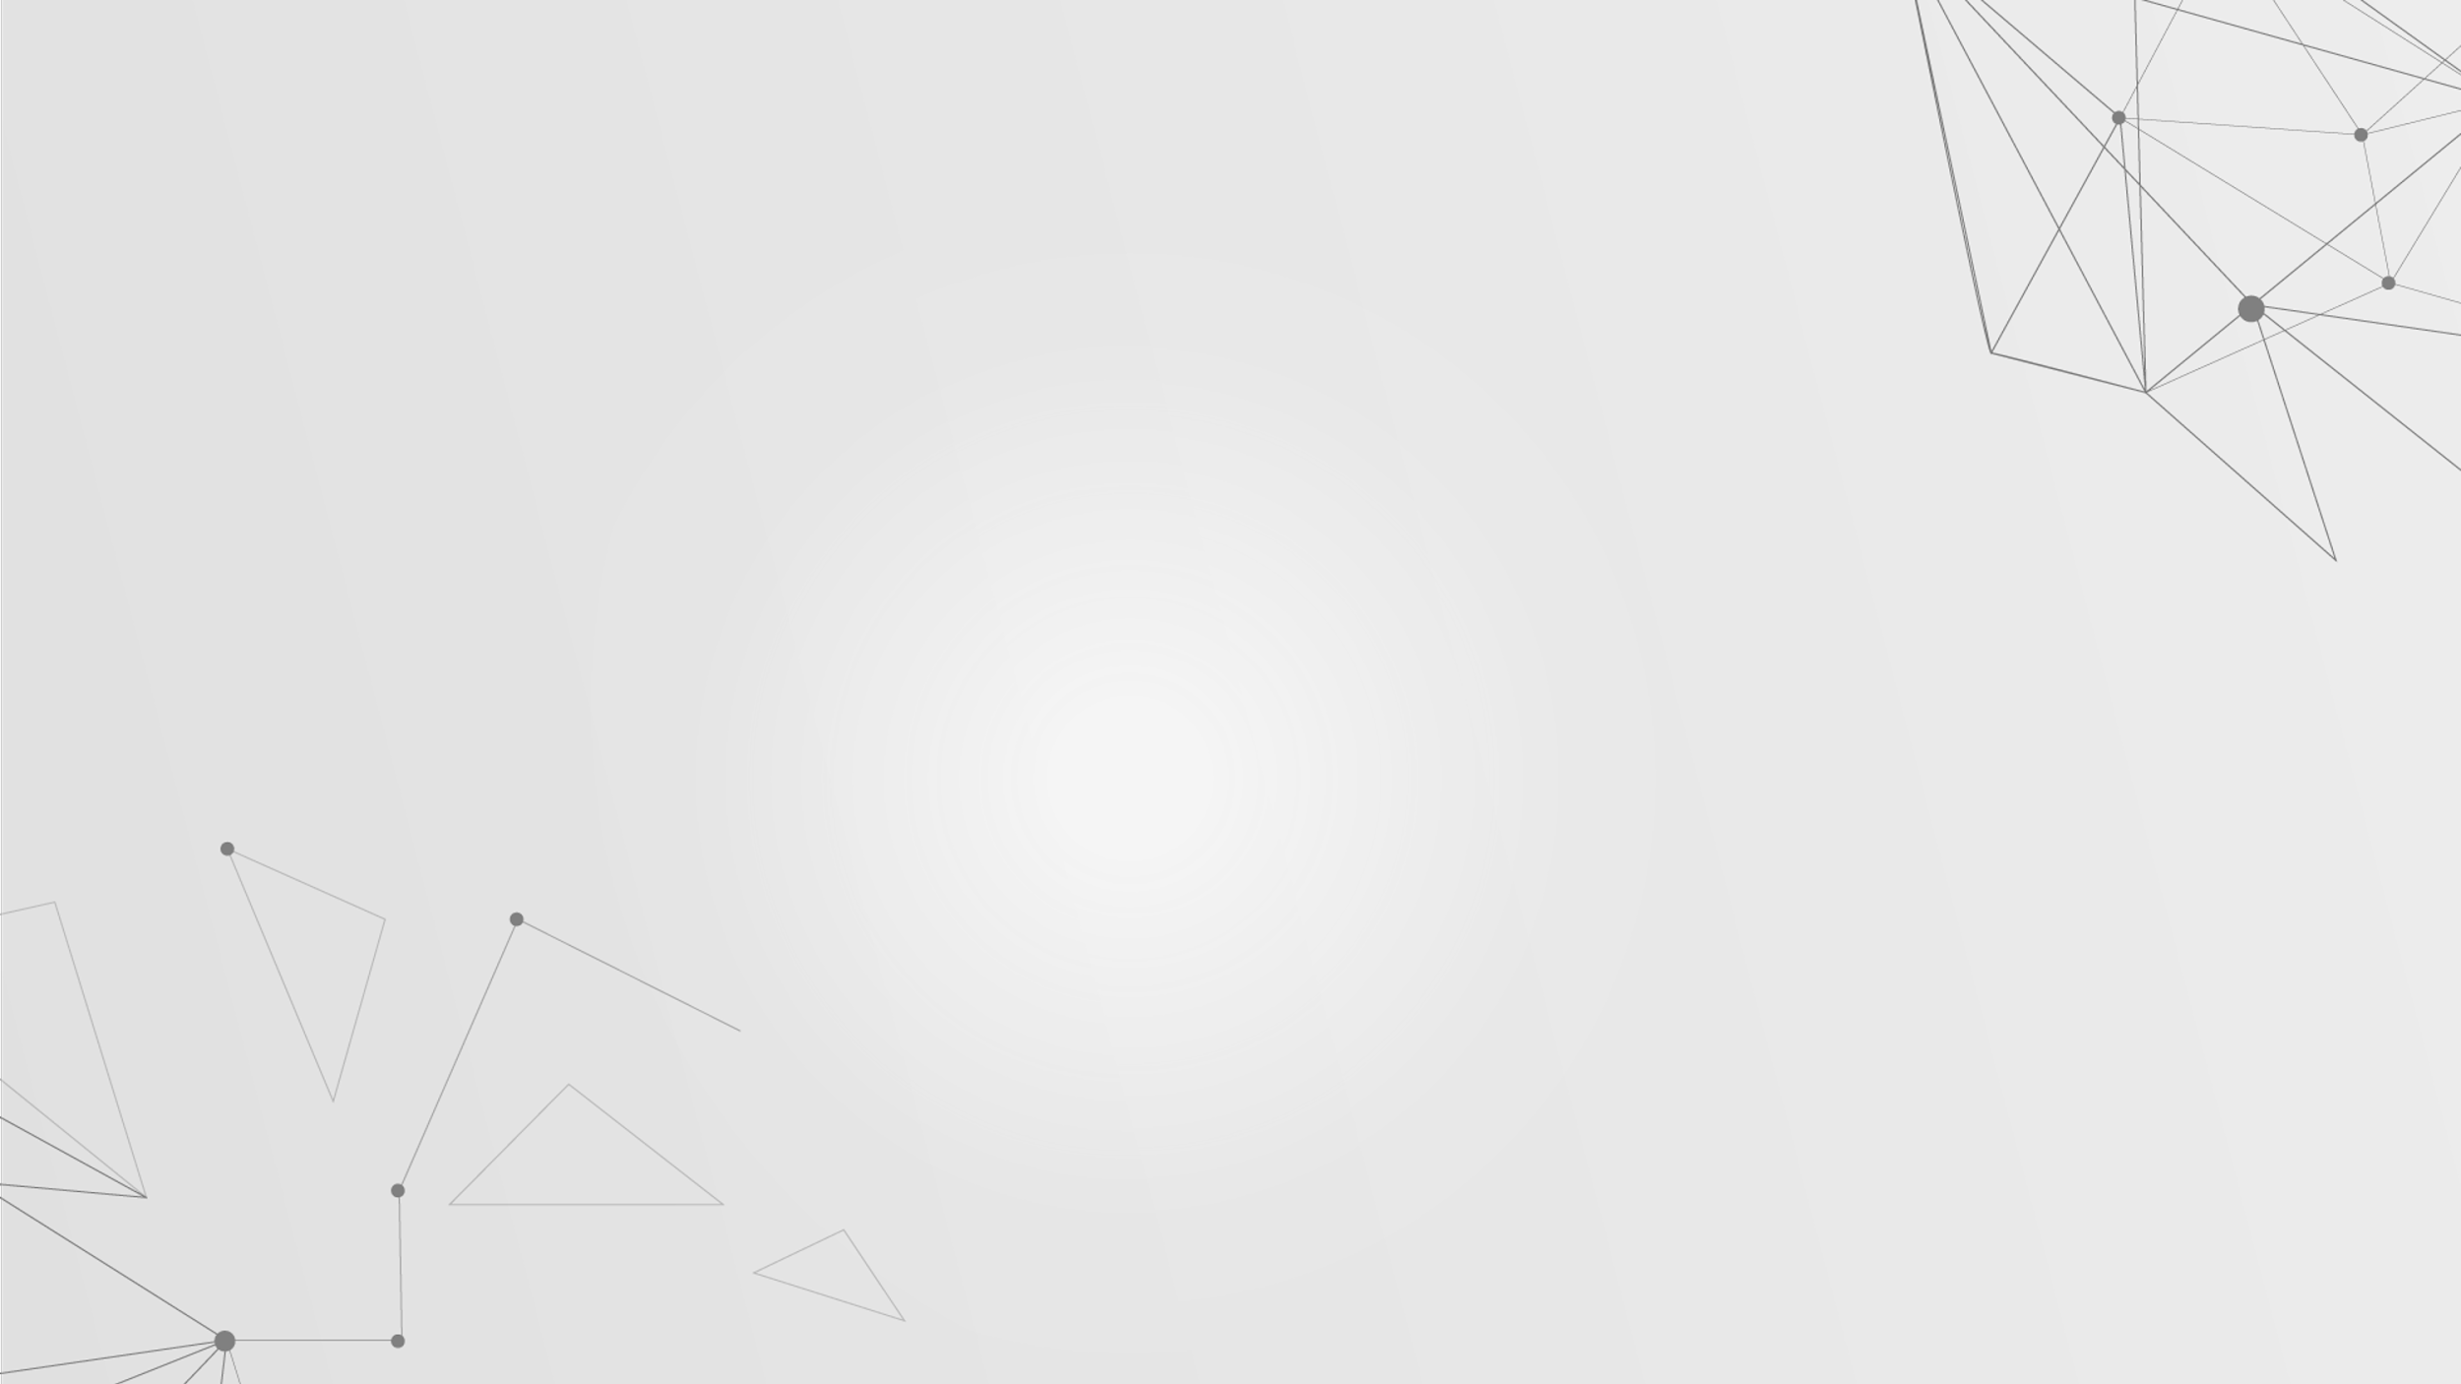
0. Outline
1. Introduction
- 1.1 Motivation and Objective
2. Hardware
- 2.1 System setup
3. System Framework
-3.1 System Framework
-3.2 Herbert Kociemba’s two-phase algorithm
-3.3 PointNetGPD
-3.4 User Interface
4. Experiment
- 4.1 Experimental Result
5. Reference

Slide 3
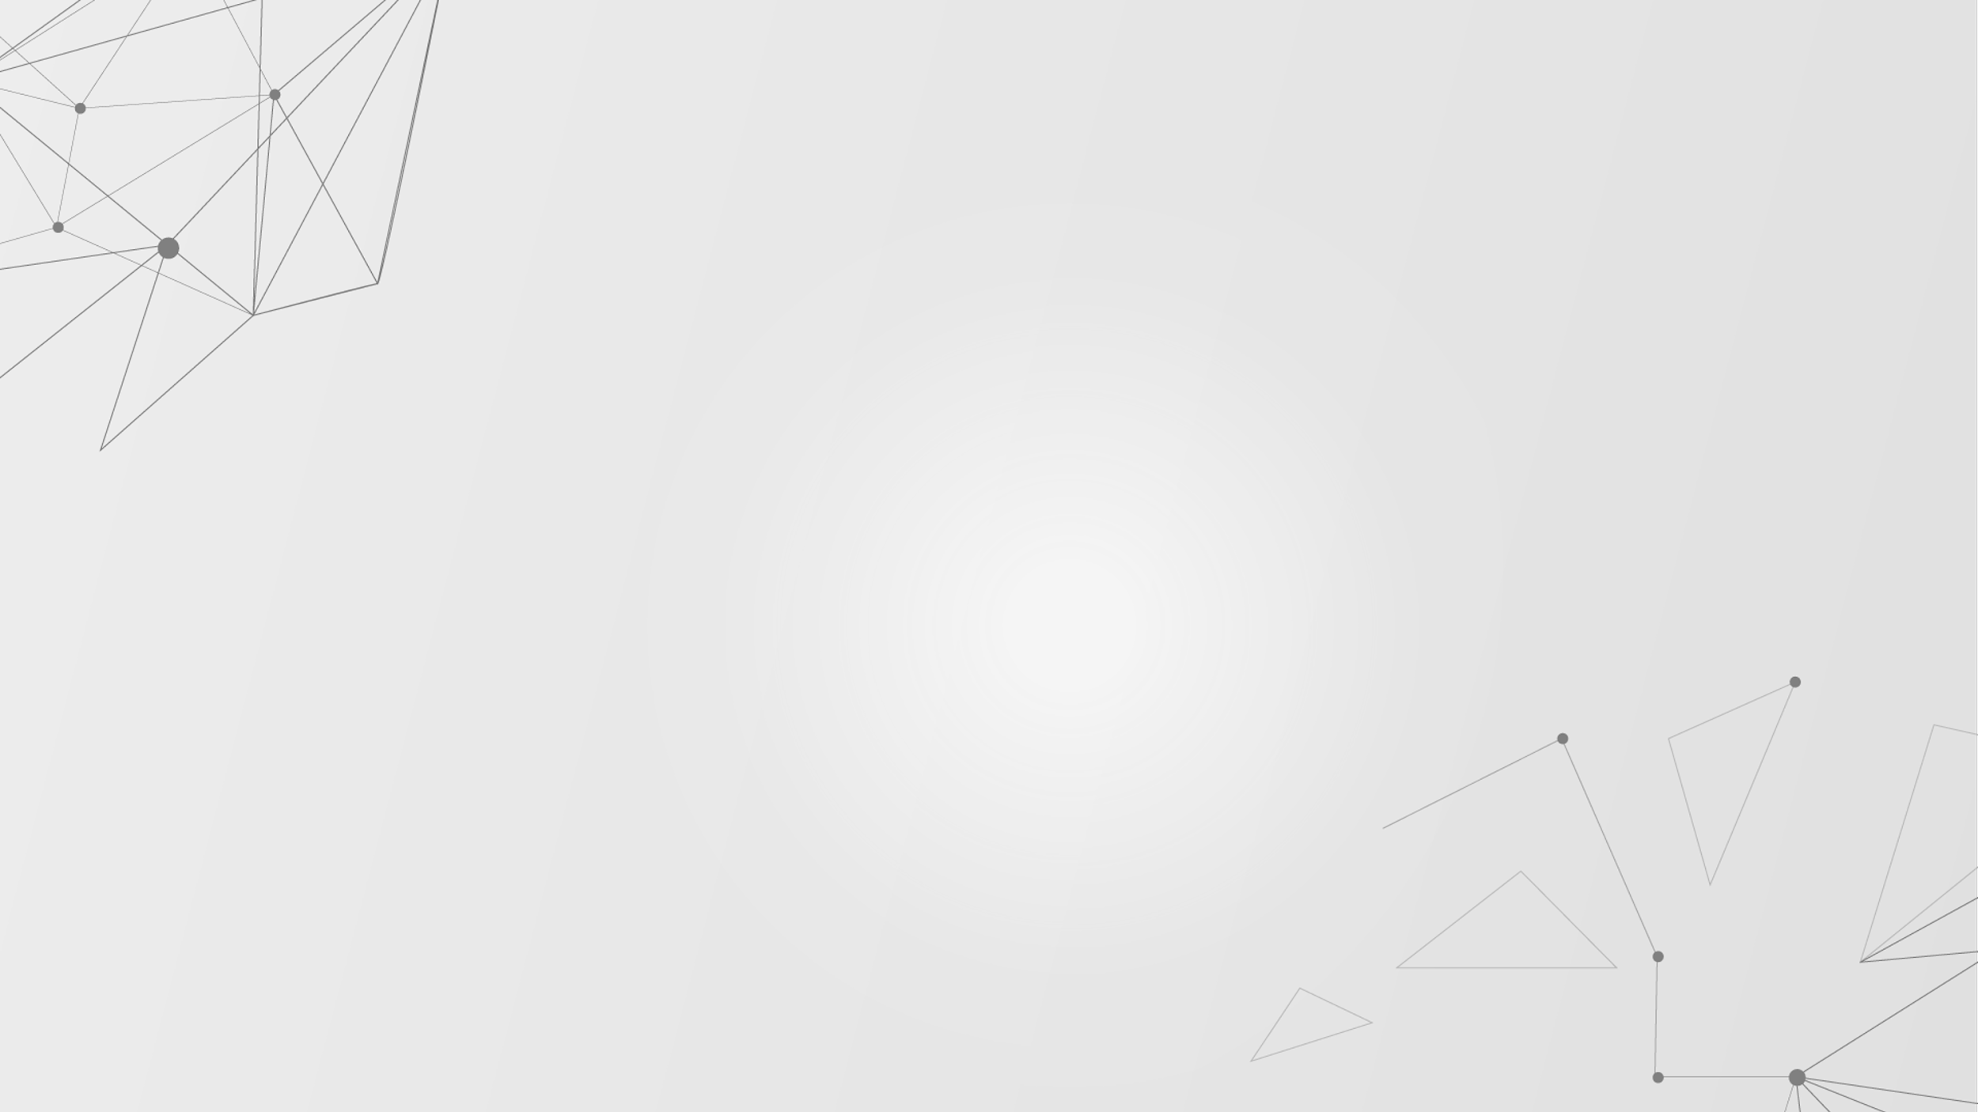
1.1 Introduction: Motivation and Objective
Motivation
Due to the rapid development of human-robot collaboration in recent years, we are now able to utilize robotic arms for more human-centered applications. Therefore, we aim to guide individuals in solving a Rubik's Cube through the integration of robotic arms, image recognition systems, and algorithms designed for solving the cube.
Objective
We are developing a Rubik's Cube collaboration system that integrates various software and hardware technologies to achieve human-robot interaction for solving the cube.
1.Sensors: RGB-D Depth Camera Realsense D435
2.Robotic Arm: TM Robot
3.Image Processing: OpenCV
4.Algorithm: Kociemba's two-phase algorithm
5.Deep Learning: PointNetGPD

Slide 4
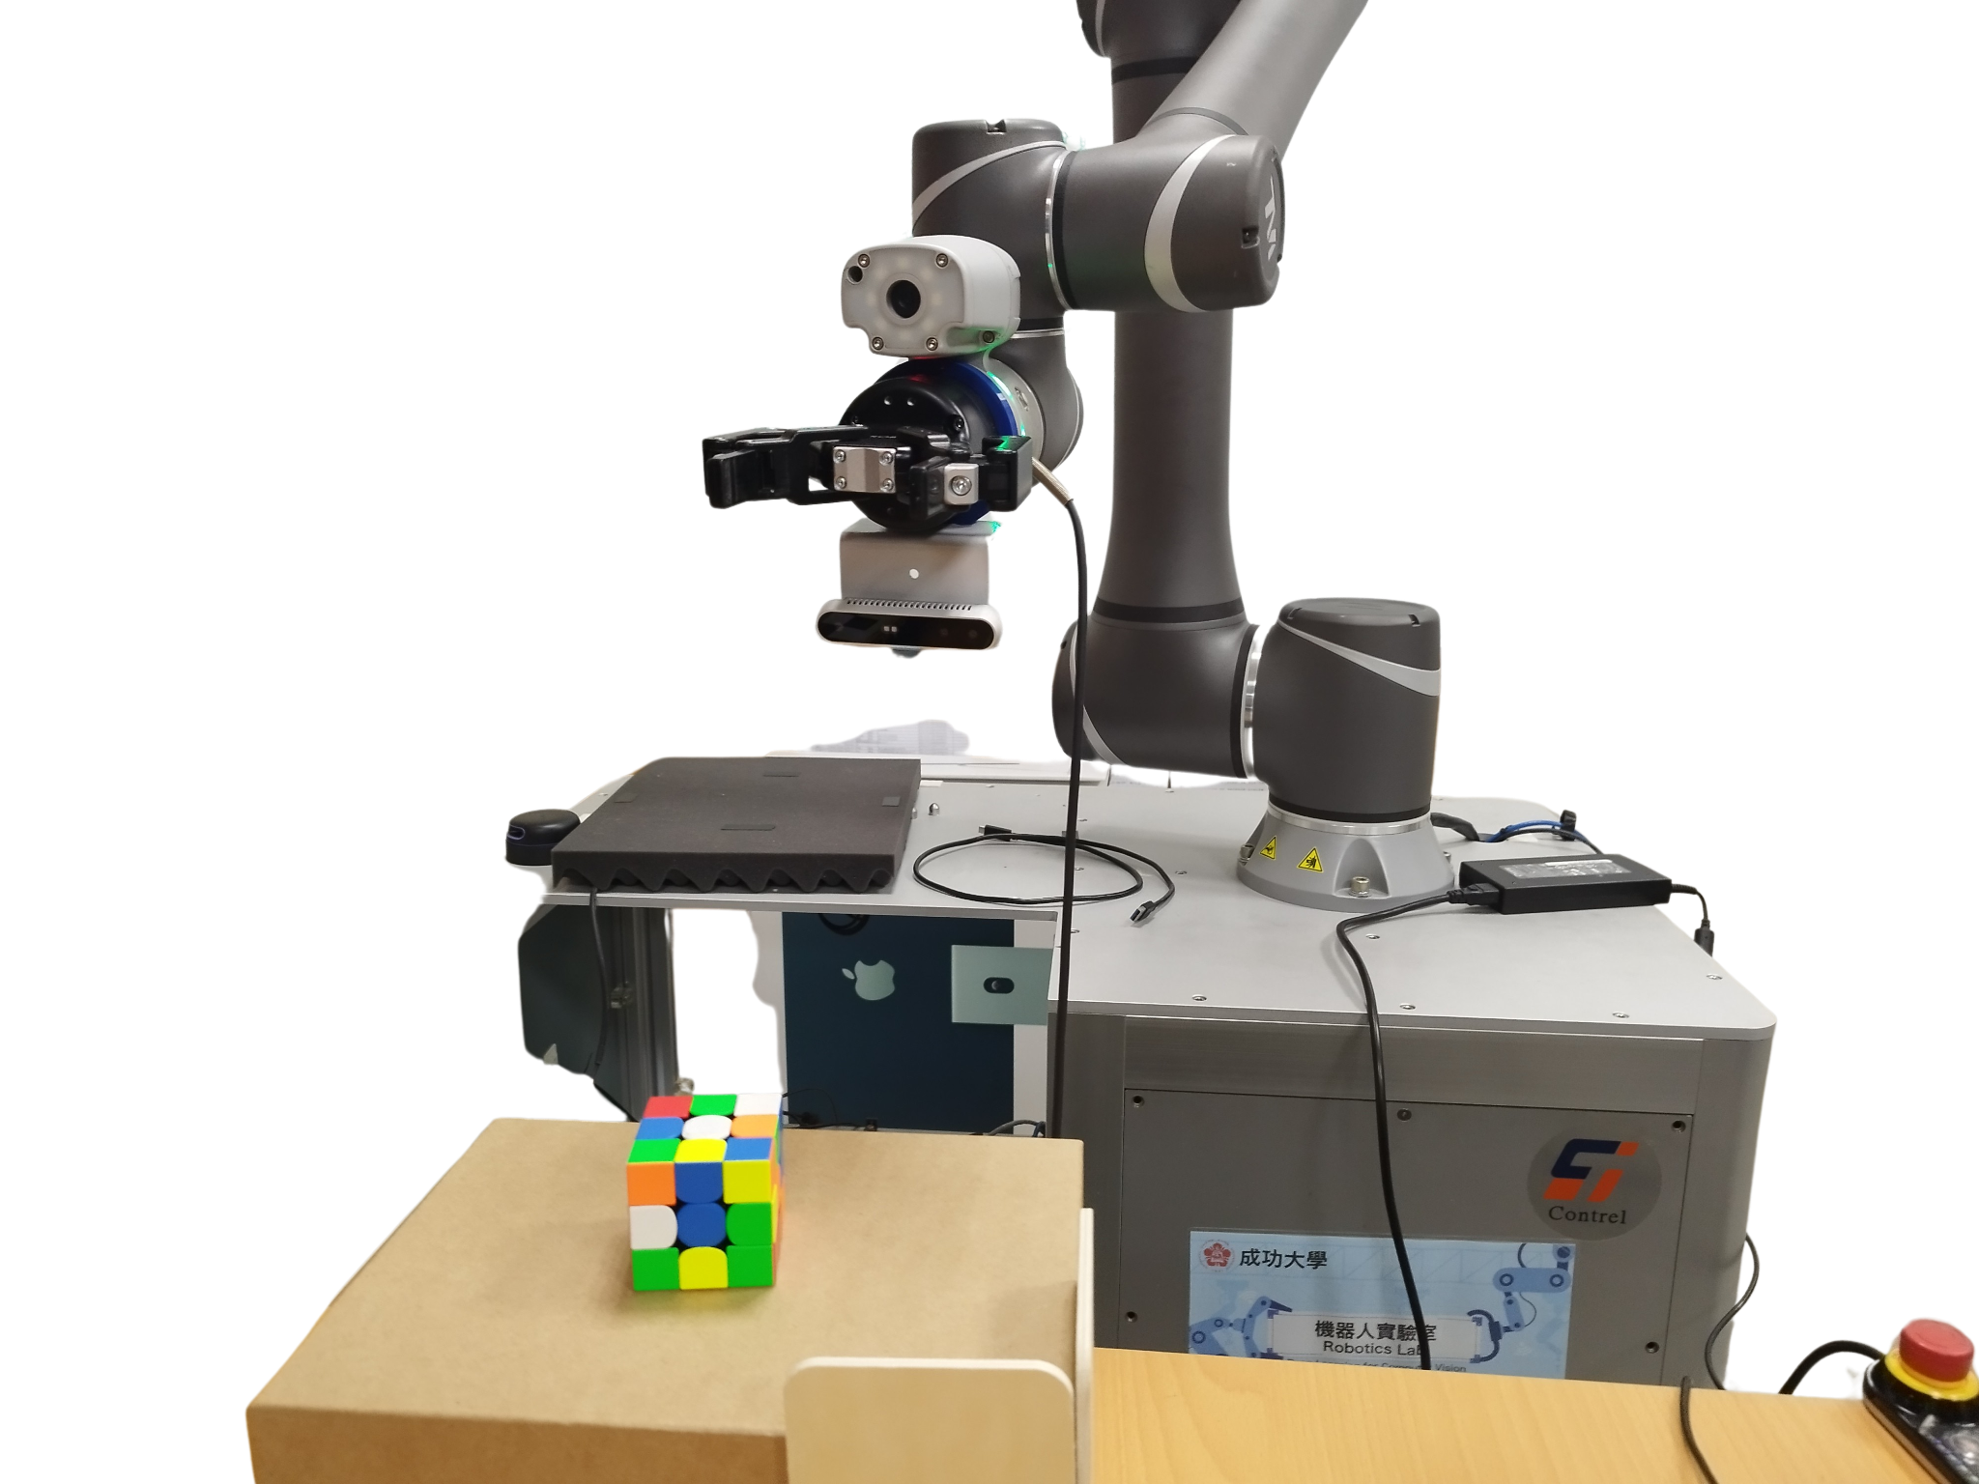

2.1 Hardware : System Setup
Sensor: Obtain the position and orientation of a Rubik's Cube.
Intel® RealSense™ Depth Camera D435
Depth output resolution: Up to 1280x720
RGB frame resolution: Up to 1920x1080
Computer: Visualize and Solve the Rubik's Cube
Ubuntu 20.04.6 LTS
Intel® Core™ i7-10750H CPU @ 2.60GHz × 12
NV166 / Mesa Intel® UHD Graphics (CML GT2)

Slide 5
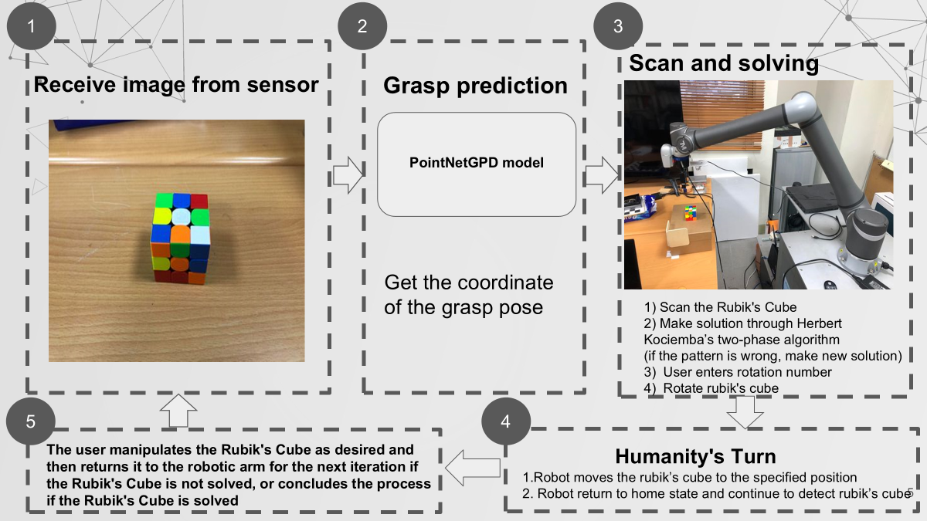
3.1.1 System Framework

Slide 6
3.1.2 System Workflow
Scanning & Algorithm
Human-Machine Collaboration
PointNetGPD (Determines the best grasp position and orientation)
Robotic arm turns x steps
Move the cube to the specified position
If incorrect:
User turns any steps, then returns control to the robotic arm
Realsense (Scans the Rubik’s Cube state)
PointNetGPD (Determines the best grasp position and orientation)
Is there a scanning error?
Move the cube to the specified position
If correct:
Herbert Kociemba’s two-phase algorithm
Realsense (Scans the Rubik’s Cube state)
If incorrect:
Determine whether the cube has rotated incorrectly.
If correct:
User inputs x, allowing the robotic arm to turn x steps each time, and simultaneously updates the UI.
Done

Slide 7
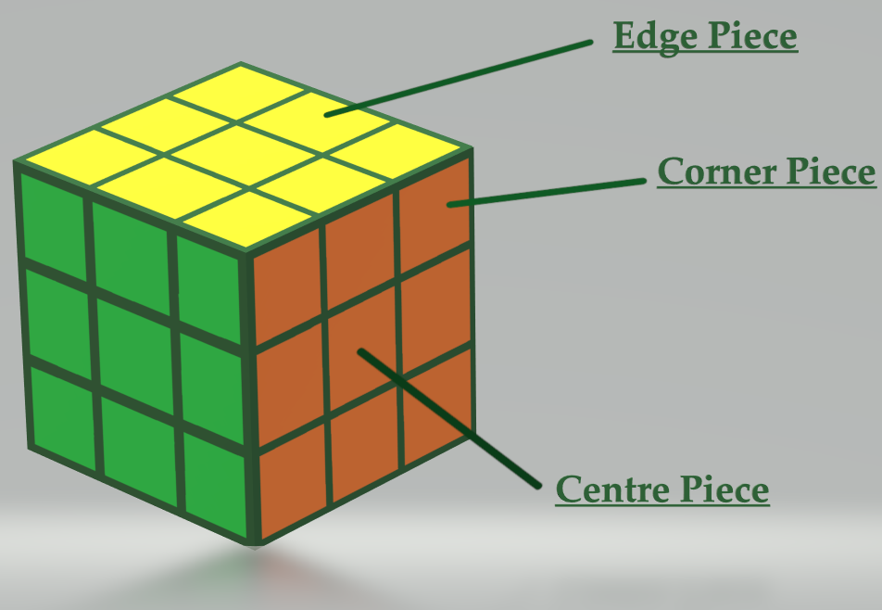
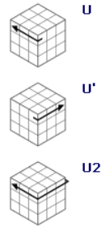
3.2.1 Rubik’s cube
Signmaster Notation & Moves
F = Front R = Right
B = Back U = Up
L = Left D = Down
Ex: UB
Left
Back
UP
Ex: UBR
Ex: U moves
Right
Front
Down

Slide 8
3.2.2 The Two-Phase-Algorithm-Implementation
Initial step
Defining basic moves and the coordinates G=<U,D,R,L,F,B>
Initializing the move tables and pruning tables
For each input, try every basic move with move table
Finding its distance with pruning table
Distance > threshold, try another basic move.If all moves are tried, then update threshold.
Distance <= threshold, recording this move
and searching next level
G1=<U,D,L2,R2,F2,B2> state
Iterative step 1

Slide 9
3.2.2 The Two-Phase-Algorithm-Implementation
G1 state
For each input, try every U,D,L2,R2,F2,B2 with move table
Finding its distance with pruning table
Distance > threshold, try another basic move.If all moves are tried, then update threshold.
Distance <= threshold, recording this move
and searching next level
Iterative step 2
Final step
Restored state

Slide 10
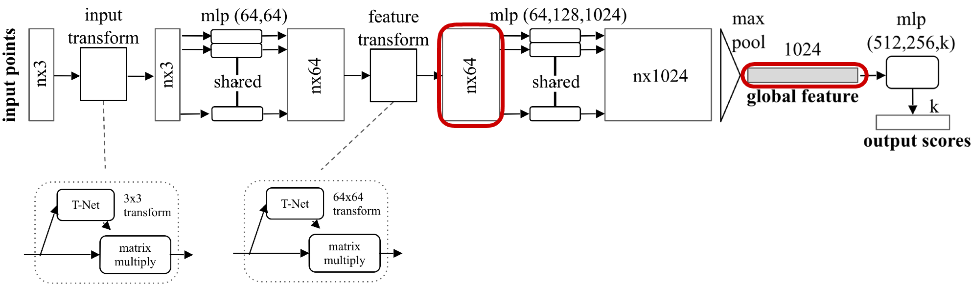
3.3.1 Pointnet(Classification)-Concept
fully connected+
batch normalization+
activation function(relu)
convolutional+batch normalization+activation function(relu)

Slide 11
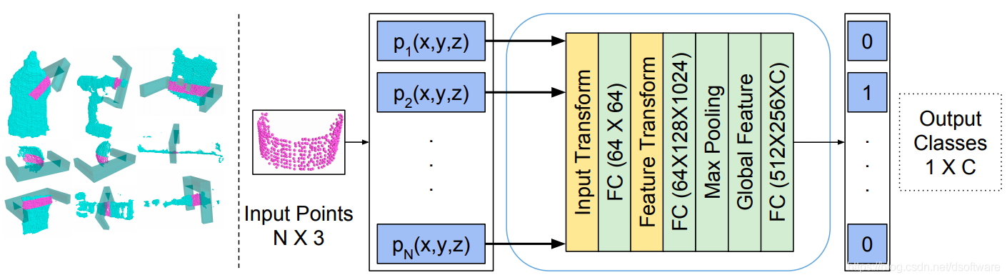
3.3.2 PointnetGPD-Concept
step1 : Taking raw sensor input from a common RGB-D camera, convert the depth map into a point cloud
step2 : several grasp candidates will be sampled with essential geometry information as constraints.
step3 : For each candidate, the point cloud within the gripper will be cropped and transformed into local gripper coordinate and finally fed into our grasp quality evaluation network.
step4 :The grasp with the highest probability will be executed.

Slide 12
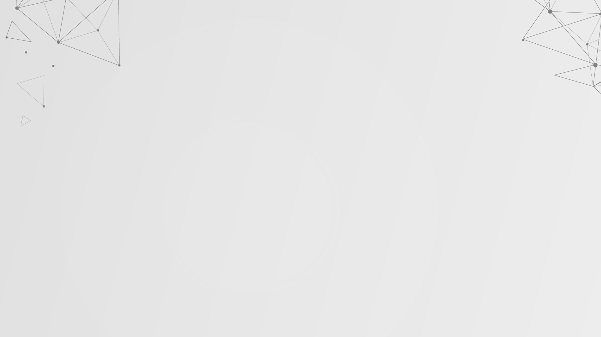
3.3.3 PointnetGPD-Implementation
CAD model +antipodal sampling
CAD+gripper geometry information+candidate grasp pose
candidate grasp pose+scene point cloud+gripper geometry information
force-closure
+
GWS analysis
scene point cloud +pointnet gpg
points within the closing area of the gripper
score
candidate grasp pose+scene point cloud+gripper geometry information
train
points within the closing area of the gripper
PointNet
good/bad grasp
input
output

Slide 13
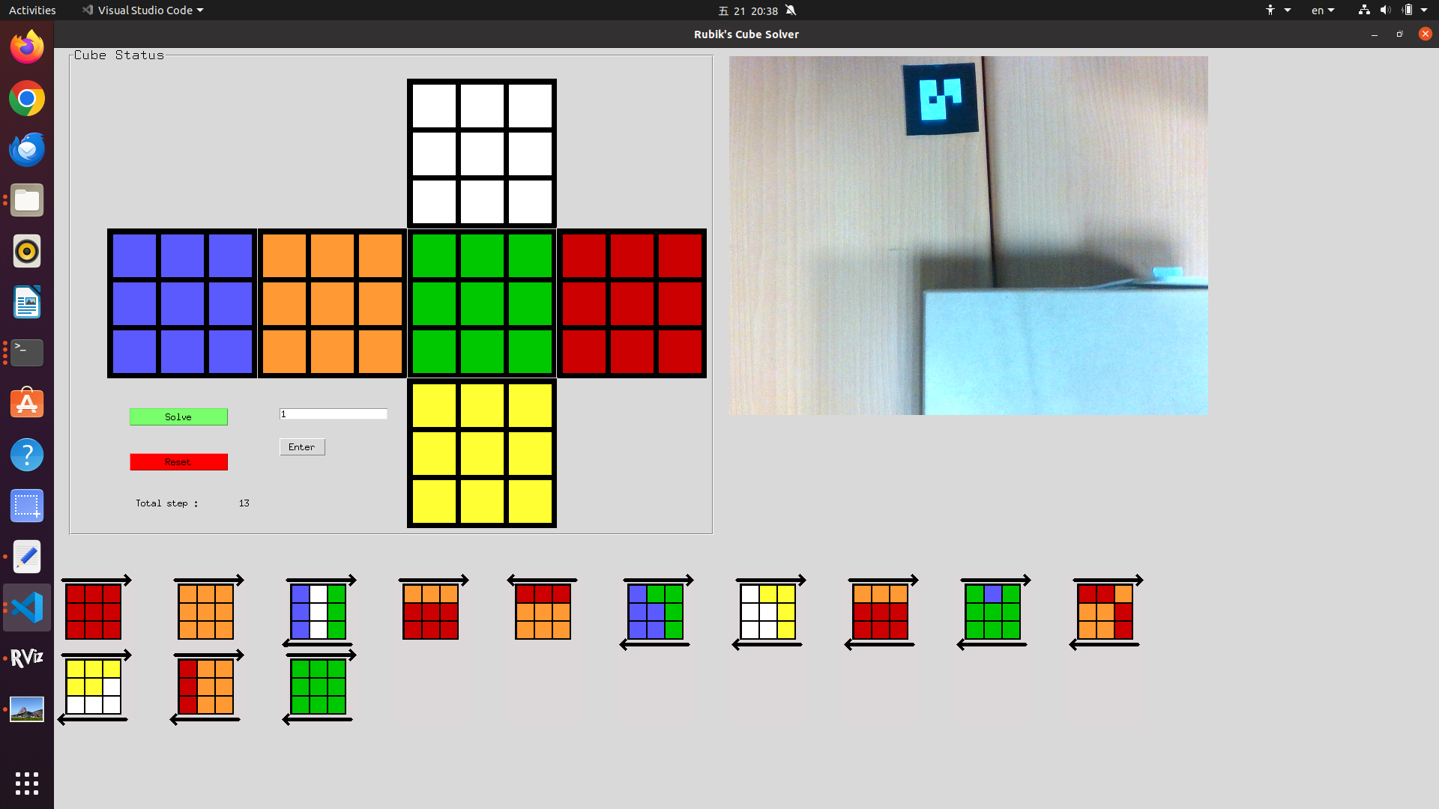
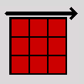
3.4 User Interface
Rubik's Cube Visualization
Current Step
Rubik's Cube Scanning Area
Solution Step Flowchart

Slide 14
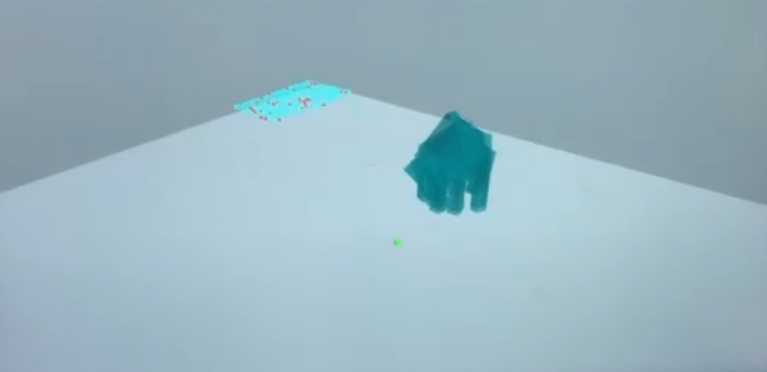
4.1 Experimental Results
Grasping Pose Candidates Produced by PointNetGPD:
The image below displays the predicted good grasping pose candidates generated by the PointNetGPD model. Since multiple good candidates may exist, overlapping instances can occur in the image. The model selects the candidate with the highest score as the final output.

Slide 15
5 Reference
1. Kociemba's two-phase algorithm
http://kociemba.org/cube.htm
https://github.com/hkociemba/RubiksCube-TwophaseSolver
2. Pointnet
https://arxiv.org/pdf/1612.00593
https://github.com/charlesq34/pointnet
3. Pointnetgpd
https://arxiv.org/pdf/1809.06267
https://github.com/lianghongzhuo/PointNetGPD

